Slide 1
LSTM Results

Slide 2
Metadata
The detector metadata - 'detector_id', 'version', 'device_id', 'lane_number', 'lane_type’
The device metadata - 'device_id’, 'version’, 'direction’, 'latitude', 'longitude’, 'mile_marker’, 'primary_road’
The original data file has data in the following format: device_id, detector_id, timestamp, interval, vehicle count and speed

Slide 3
Data preprocessing
First we create a device id and a detector id mapping – this maintains the most recent version of the device.
We maintain the device – longitude, latitude, direction mapping.
We create a method that takes a device id, its corresponding mile marker. We then find all the devices in the same primary road with the same direction.
Now we sort the resulting devices by the mile marker and obtain the devices with the downstream mile markers
For all the neighboring devices, choose all the entries from the data file and filter the entries for the current row timestamp

Slide 4
Data preprocessing
With this preprocessed current device and neighboring device data, we obtain the physical distance using the latitude, longitude device mapping. We also take the time difference into consideration for the current row and the neighboring device rows.
For the current row, we choose an entry for the same device, detector combination fifteen minutes into the future – this will be our train y value

Slide 5
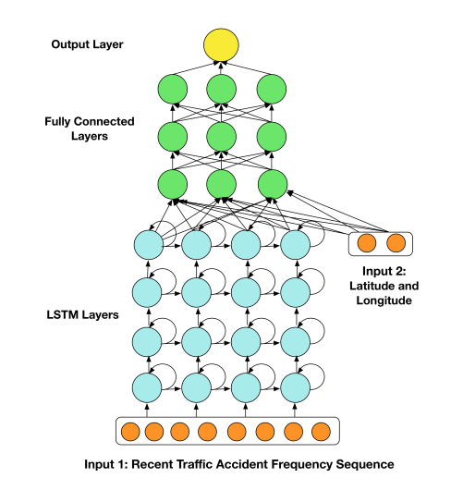
Literature survey
‘A Deep Learning Approach to the Citywide Traffic Accident Risk Prediction’ makes use of the following LSTM architecture with very similar spatial and temporal preprocessing of data
The first input is the sequence of recent traffic accident frequency, and it is input to the first LSTM layer. The second input contains the longitude and latitude of the region center that the model is expected to predict.
The latitude longitude information is directly input into fully connected layers.

Slide 6
Reason for choosing LSTM
LSTM addresses the vanishing gradient problem – the network forgets the patterns that happened before a longer interval of time due to gradient descent and backpropagation through each layer of the network.
“LSTM can capture the periodic feature of traffic accident, and traditional RNNs shows poor performance and intrinsic difficulties in training when it has long time period. These weaknesses have been proved in researches related with traffic flow prediction[10]. On another hand, the explicit memory cell in LSTM can avoid the problems of gradient vanish or gradient explosion existed in traditional RNNs.” – quoted by ‘A Deep Learning Approach to the Citywide Traffic Accident Risk Prediction’

Slide 7
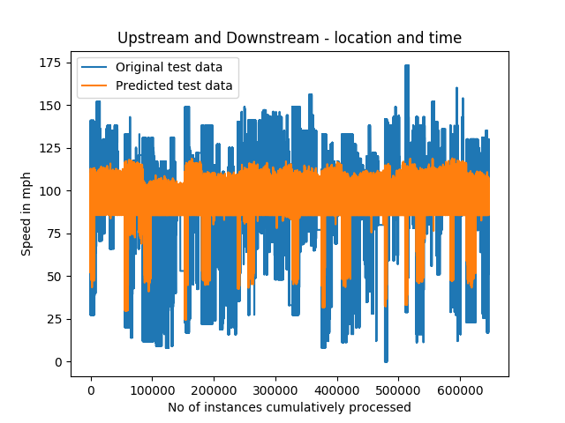
RMSE for 23 downstream and upstream stations
For ‘Adam optimizer’ and 5 epochs – Accuracy can be improved by adding more LSTM layers or by making LSTM stateful with memory.
Train Score: 27.11 RMSE
Test Score: 27.03 RMSE

Slide 8
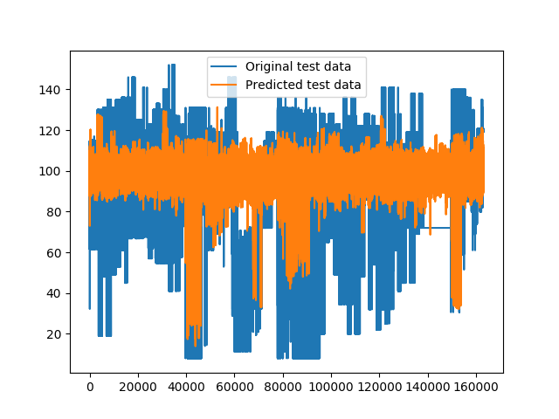
RMSE for 13 downstream stations
For ‘Adam optimizer’ and 5 epochs – Accuracy can be improved by adding more LSTM layers or by making LSTM stateful with memory.
Train Score: 23.18 RMSE
Test Score: 28.05 RMSE
X-axis is the number of datapoints

Slide 9
RMSE for 23 downstream stations
For ‘Adam optimizer’ and 2 epochs – Accuracy can be improved by adding more LSTM layers or by making LSTM stateful with memory.
Train Score: 48.74 RMSE
Test Score: 49.58 RMSE
X-axis is the number of datapoints

Slide 10
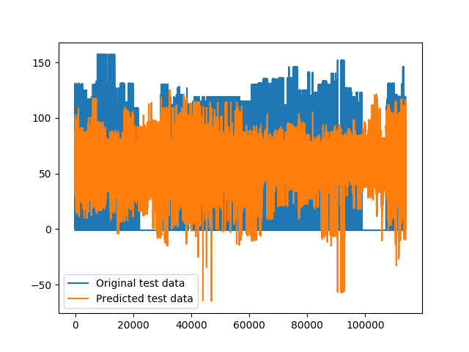
RMSE for 20 downstream stations – using only location data
For ‘Adam optimizer’ and 2 epochs – Accuracy can be improved by adding more LSTM layers or by making LSTM stateful with memory.
Train Score: 49.12 RMSE
Test Score: 50.71 RMSE
X-axis is the number of datapoints

Slide 11
Scope for improvements
Using both upstream and downstream stations
Trying other optimizers and loss functions(Hyperparameter optimization)
Stacked LSTM with stateful memory
Increasing the number of hidden layers and lstm layers
Increasing the number of epochs

